Slide 1




Exploring Web Development Through an Internship at Nexus
Embarking on an internship at Nexus provided me with a transformative experience in the world of web development. Beyond the classroom, I gained invaluable hands-on experience, honed my technical skills, and discovered the dynamic nature of the tech industry. This internship served as a stepping stone, equipping me with the knowledge and confidence to tackle real-world challenges and paving the way for a promising career in web development.

Slide 2


Comprehensive Internship Overview
1
Duration
The internship at Nexus spanned a duration of 12 weeks, providing me with ample time to immerse myself in various web development projects and technologies.
2
Key Technologies
During the internship, I had the opportunity to work with a wide range of technologies, including JavaScript for frontend development, Laravel for backend implementation, and Microsoft Azure for cloud services.
3
Hands-on Projects
The internship involved hands-on projects covering areas such as frontend and backend development, API integration, and the implementation of cloud-based solutions, enabling me to apply my knowledge in real-world scenarios.

Slide 3

About the Company
Company Overview
Company Culture
Company Mission
A leading digital agency specializing in creating innovative web solutions for clients across various industries.
Collaborative, fast-paced, and supportive environment that encourages creativity and professional growth.
To deliver outstanding digital experiences that drive business success for our clients.

Slide 4

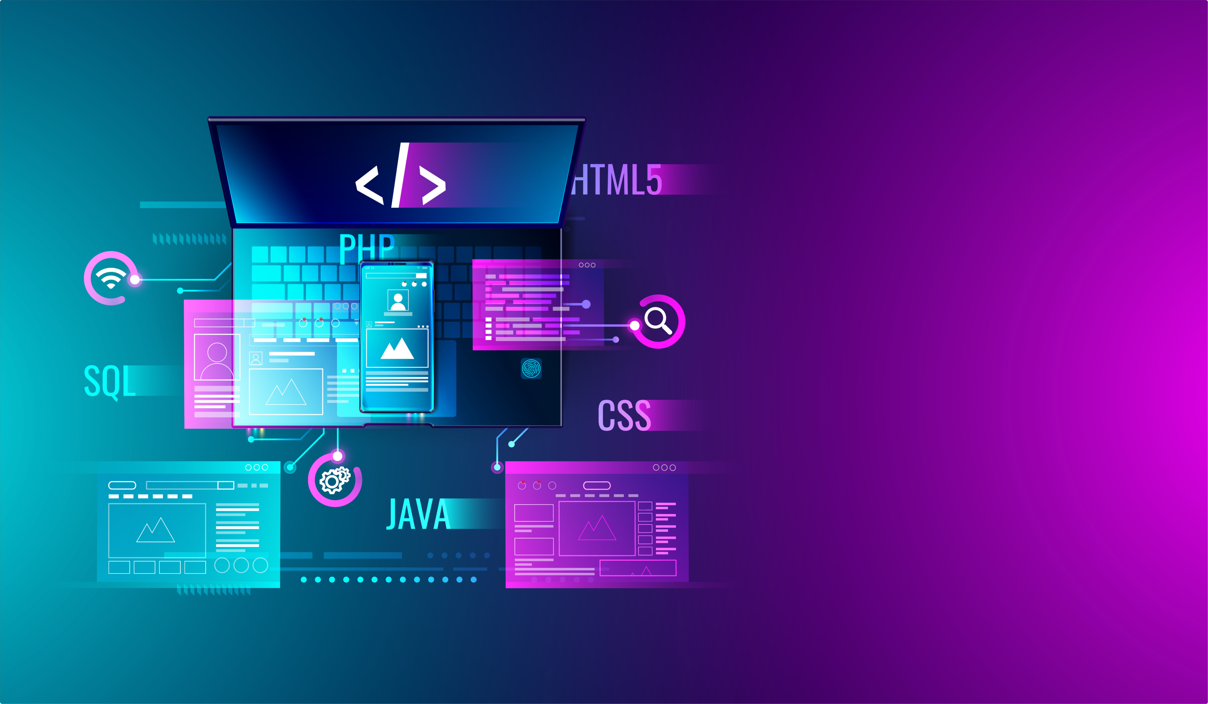
My Role and Responsibilities
1
Front-end Development
Responsible for building responsive and visually appealing user interfaces using HTML, CSS, and JavaScript.
2
Back-end Integration
Collaborated with the back-end team to integrate web applications with server-side functionality.
3
Testing and Debugging
Conducted thorough testing and troubleshooting to ensure the optimal performance of web applications.
4
Project Collaboration
Participated in project meetings, discussions, and brainstorming sessions to contribute ideas and solve problems.

Slide 5
Mastering Web Development Tasks
SWOT Analysis
E-commerce Tech Stack and Architecture
Geofencing Program
I conducted a comprehensive SWOT (Strengths, Weaknesses, Opportunities, Threats) analysis to assess the internal and external factors influencing the web development projects. This exercise helped me identify key areas for improvement and strategic decision-making.
One of my key responsibilities was the development of a geofencing program, which involved the integration of location-based services to provide targeted user experiences. This project challenged me to work with JavaScript and relevant APIs to create a seamless and dynamic location-based functionality.
As part of my internship, I researched and implemented a scalable e-commerce technology stack, including the selection of appropriate frameworks, databases, and cloud-based services. This hands-on experience allowed me to understand the complexities of building a robust and efficient online retail platform.

Slide 6





Networking and Professional Development
Mentorship
Participated in a mentorship program to receive guidance and insights from experienced web developers.
Industry Meetups
Attended local web development meetups to connect with professionals, learn about industry trends, and share knowledge.
Online Courses
Completed several online courses and tutorials to continuously improve my web development skills.

Slide 7

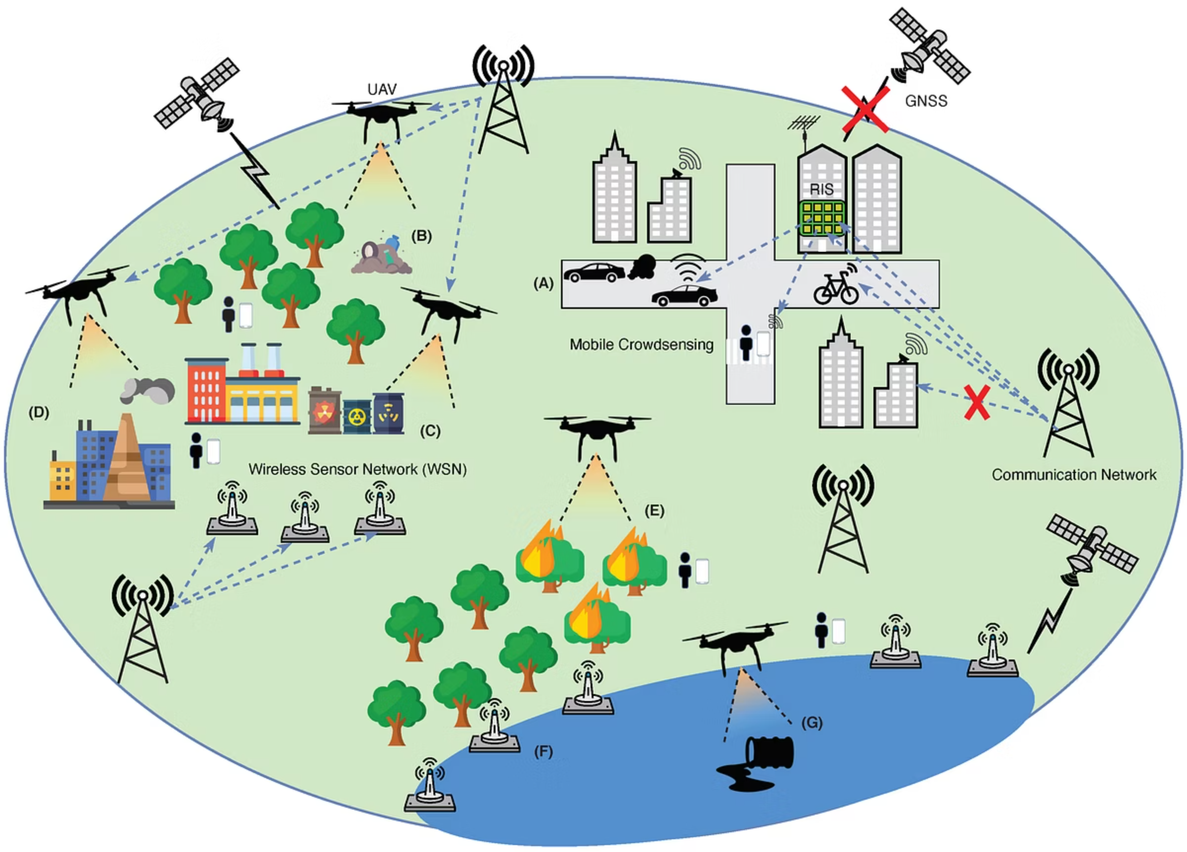
Expanding Horizons in Web Development
1
Environmental Monitoring Program
I contributed to the development of an environmental monitoring program, leveraging sensors and real-time data collection to track and analyze environmental conditions. This project allowed me to explore the integration of IoT (Internet of Things) technologies with web-based applications.
2
Apps for Farmers
During the internship, I had the opportunity to collaborate on the creation of web-based applications tailored for farmers. These apps focused on providing valuable information, tools, and resources to support agricultural practices, showcasing the versatility of web development in addressing industry-specific needs.
3
Website Creation and Documentation
I was tasked with building and documenting a responsive website for the company, which involved implementing best practices in user experience, design, and content management. This experience honed my skills in creating visually appealing and user-friendly web experiences.
4
CRUD Operations in Laravel
Leveraging the Laravel framework, I worked on defining and documenting CRUD (Create, Read, Update, Delete) operations, ensuring the efficient management of data within the web applications. This project strengthened my understanding of backend development and database integration.

Slide 8
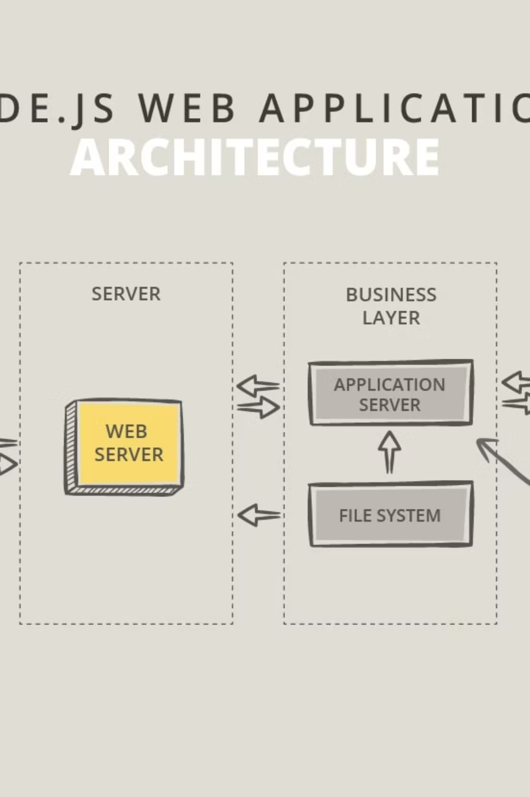
Designing and Developing Scalable Web Solutions
The design and development processes I followed during the internship involved the use of various technical tools and methodologies. This included the implementation of JavaScript for the Geofencing API, the integration of Laravel for backend development, and the utilization of Microsoft Azure for cloud-based services.
Throughout the internship, I adhered to industry-standard development methodologies, such as Agile and Scrum, to ensure efficient project management, collaboration, and the delivery of high-quality web solutions. This experience equipped me with valuable skills in navigating complex development workflows.
A key focus of my internship was the design and implementation of scalable web architectures. This involved researching and incorporating technologies that could accommodate growing user demands, data volumes, and future expansion requirements, preparing me for the challenges of building robust and scalable web applications.

Slide 9


Challenges Faced and Lessons Learned
Tight Deadlines
Cross-team Collaboration
Learned to prioritize tasks, manage time effectively, and communicate proactively to meet project deadlines.
Developed stronger communication and collaboration skills to work effectively with different team members.
Troubleshooting Issues
Adaptability
Improved problem-solving abilities by identifying and resolving complex technical issues during development.
Demonstrated the ability to adapt to changes in project requirements and work with a flexible mindset.

Slide 10





Lessons Learned and Future Prospects
Technical Expertise
The internship at Nexus empowered me with a wealth of technical skills, including proficiency in frontend and backend development, API integration, and the effective use of cloud-based services. These capabilities have equipped me to tackle complex web development challenges with confidence.
Collaborative Mindset
Working alongside experienced developers and cross-functional teams during the internship fostered my ability to collaborate effectively, share ideas, and contribute to the overall success of web development projects. This experience has instilled in me a strong appreciation for teamwork and communication in the tech industry.
Problem-Solving Acumen
The hands-on nature of the internship honed my problem-solving skills, allowing me to navigate complex technical challenges, think critically, and devise innovative solutions. This mindset will be crucial as I continue to grow and adapt to the ever-evolving landscape of web development.

Slide 11

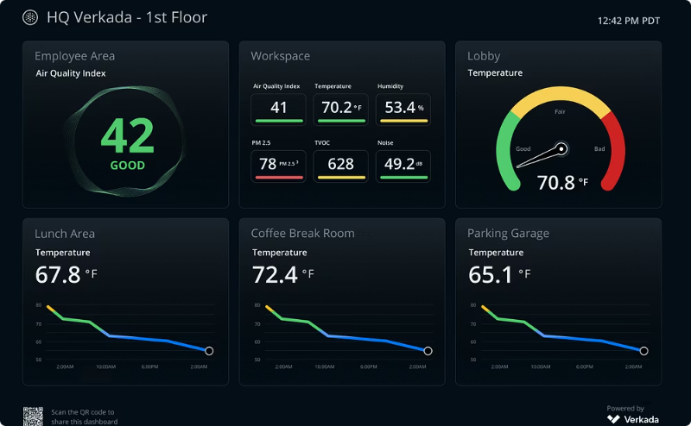
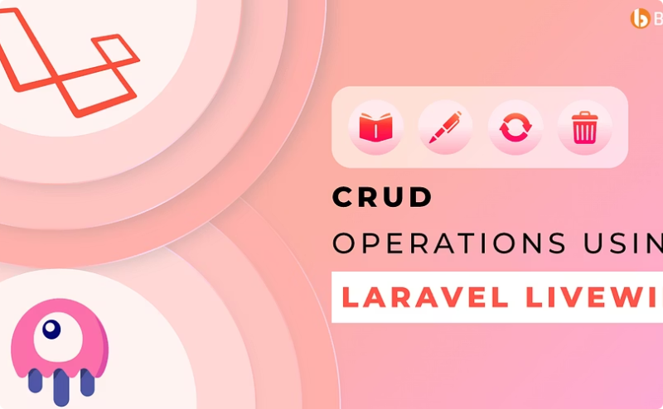

Showcasing Web Development Achievements
Geofencing API Integration
Environmental Monitoring Dashboard
Efficient CRUD Operations in Laravel
During the internship, I successfully integrated a robust Geofencing API, enabling location-based services and targeted user experiences within the web applications. This achievement showcases my ability to work with advanced technologies and APIs to enhance the functionality and user experience of web-based solutions.
As part of the environmental monitoring program, I developed a visually appealing and user-friendly dashboard that displayed real-time data from sensor networks. This project demonstrates my skills in creating intuitive and data-driven web interfaces that support decision-making and environmental sustainability initiatives.
Through my work in the internship, I showcased my expertise in implementing and documenting CRUD operations using the Laravel framework. This achievement highlights my understanding of backend development, data management, and the importance of robust documentation for maintaining and scaling web applications.

Slide 12





Embracing the Future of Web Development
Continuous Learning
The internship experience has instilled in me a deep appreciation for the importance of continuous learning in the rapidly evolving web development landscape. I am committed to staying up-to-date with the latest technologies, methodologies, and industry trends to ensure my skills remain relevant and adaptable.
Collaborative Mindset
The collaborative nature of the internship has reinforced my belief in the value of teamwork and effective communication in web development projects. Moving forward, I will strive to foster a collaborative mindset, actively seeking opportunities to share knowledge, learn from others, and contribute to the success of cross-functional teams.
Innovative Problem-Solving
The internship has sharpened my problem-solving abilities, equipping me with the skills to tackle complex web development challenges with creativity and critical thinking. I am excited to apply this mindset to future projects, continuously seeking innovative solutions that push the boundaries of what is possible in the world of web development.

